Slide 1
Doctors believes that the average teen sleeps on average no longer than 10 hours per day
A company has started that their straw machine makes straws that are 4 mm diameter. A worker believes that the machine no longer makes straw of 4 mm diameter
The school board claims that at least 60% of students bring a phone to school

Slide 2
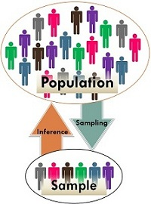
Inferential Statistics
It allows you to make inferences from that data. With inferential statistics, you take data from sample and make generalizations about a population.
For example, you might stand in a mall and ask a sample of 100 people if they like shopping at Levis.
You could make a bar chart of yes or no answers (that would be descriptive statistics) of the population (all shoppers in all malls)
Or you could use inferential statistics to reason that around 75-80% of the population like shopping at Levis taking multiple samples.
Hypothesis Testing

Slide 3
Introduction
Hypothesis testing is a kind of statistical inference that involves asking a question, collecting data, and then examining what the data tells us about how to proceed.
Hypothesis test is a statistical procedure that’s designed to test a claim.
Typically the claim is being made about a population
For example, the claim that 25% of all men are smokers is a claim about the proportion(that’s a parameter) of all men(that’s a population) who smoke.

Slide 4
Importance of Hypothesis
It enables the researcher to develop a specific direction as well as better understanding about the subject matter of the study
Research/Study without hypothesis is like a sailor in the sea without compass.
It gives difference b/w scientific and unscientific, false and true research. It prevents blind research and give accuracy.
A proper formulated hypothesis may lead to a good reasonable, utilized and proper conclusion.

Slide 5
Null and Alternative Hypothesis
The hypothesis to be tested is called the null hypothesis and given the symbol H0.
The null hypothesis states that there is no difference between a hypothesized population mean and a sample mean. It is the status quo hypothesis.
We test the null hypothesis against an alternative hypothesis, which is given the symbol Ha. The alternative hypothesis is often the hypothesis that you believe yourself!
alternative hypothesis includes the outcomes not covered by the null hypothesis

Slide 6

We have a medicine that is being manufactured and each pill is supposed to have 14 milligrams of the active ingredient. What are our null and alternative hypotheses?

Slide 7
A package of mint gum claims that the flavor lasts more than 39 minutes. What would be the null hypothesis of a test to determine the validity of the claim? What sort of test is this?
H0>= 39
HA<39

Slide 8
A researcher claims that black horses are, on average, more than 30 lbs heavier than white horses, which average 1100 lbs. What is the null hypothesis, and what kind of test is this?
H0 : μ <= 1130 lbs
HA: μ>1130

Slide 9
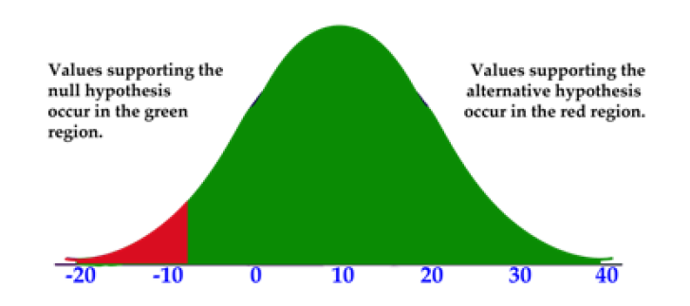
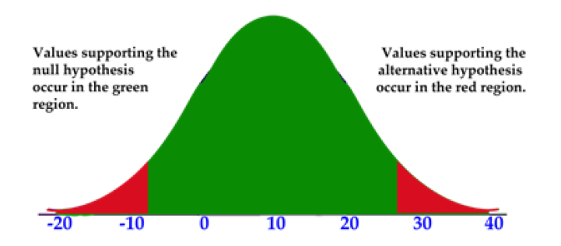
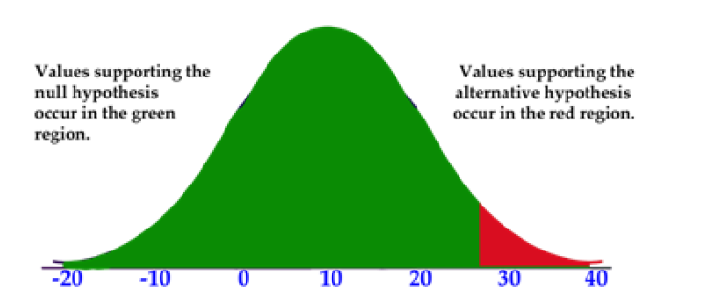
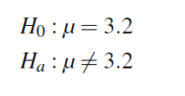
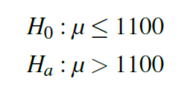

Hypothesis Tests and Their Tails
Lower/left tailed
two tailed
upper/right tailed

Slide 10
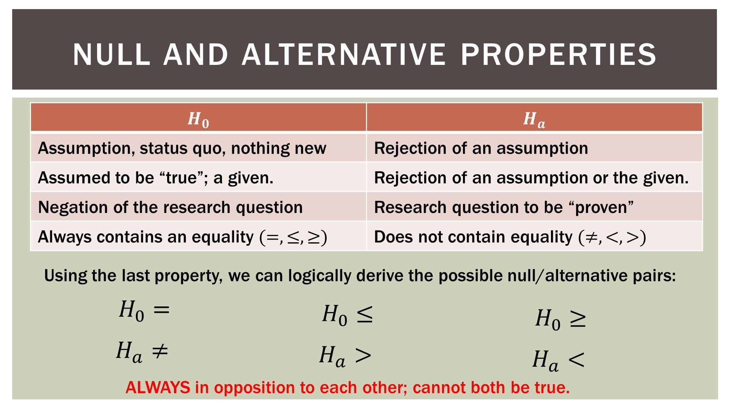

Slide 11
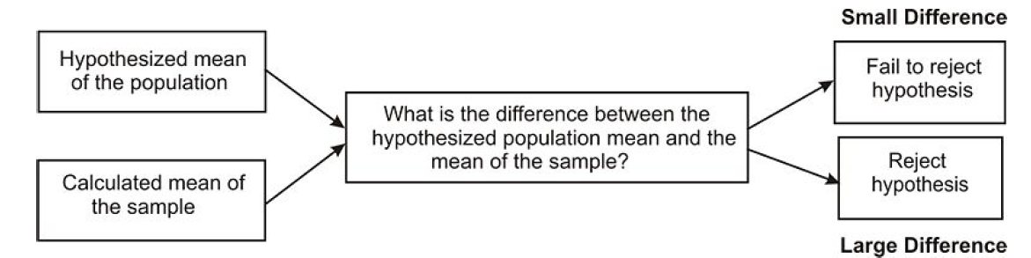
Deciding Whether to Reject the Null Hypothesis:
The alternative hypothesis can be supported only by rejecting the null hypothesis.
To reject the null hypothesis means to find a large enough difference between your sample mean and the hypothesized (null) mean.

Slide 12
When a hypothesis is tested, a statistician must decide on how much of a difference between means is necessary in order to reject the null hypothesis.
Statisticians choose a level of significance or alpha level for their hypothesis test. Similar to the significance level you used in constructing confidence intervals, this alpha level tells us how improbable a sample mean must be for it to be deemed "significantly different" from the hypothesized mean.
An alpha level of 0.05 means that we will consider our sample mean to be significantly different from the hypothesized mean if the chances of observing that sample mean are less than 5%.
Similarly, an alpha level of 0.01 means that we will consider our sample mean to be significantly different from the hypothesized mean if the chances of observing that sample mean are less than 1%.

Slide 13
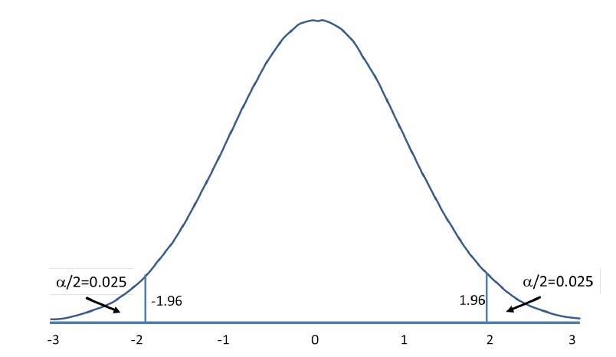
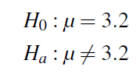
Two-tailed Hypothesis Tests
In a two-tailed test, you will reject the null hypothesis if your sample mean falls in either tail of the distribution.
The alpha level (let’s assume .05) is split across the two tails. The curve shows the critical regions for a two-tailed test.
These are the regions under the normal curve that, together, sum to a probability of 0.05. Each tail has a probability of 0.025. The z-scores that designate the start of the critical region are called the critical values

Slide 14
If the sample mean taken from the population falls within these critical regions, or "rejection regions," we would conclude that there was too much of a difference and we would reject the null hypothesis.
However, if the mean from the sample falls in the middle of the distribution (in between the critical regions) we would fail to reject the null hypothesis.

Slide 15

One-Tailed Hypothesis Test
We would use a single-tail hypothesis test when the direction of the results is anticipated or we are only interested in one direction of the results.
Claiming that the average SAT score of graduating seniors was GREATER than 1,110

Slide 16
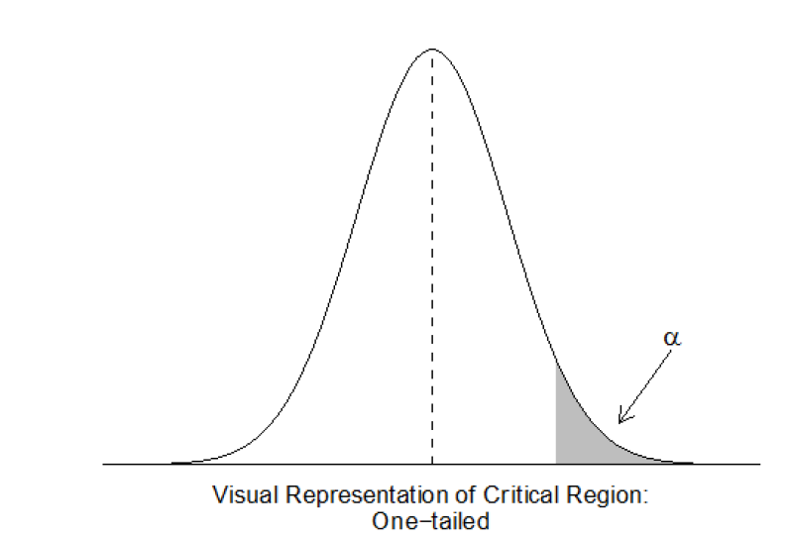
we have only one critical region because we put the entire critical region into just one side of the distribution.
When the alternative hypothesis is that the sample mean is greater, the critical region is on the right side of the distribution (see below).
When the alternative hypothesis is that the sample mean is smaller, the critical region is on the left side of the distribution.

Slide 17
An ice pack claims to stay cold between 35 and 65 minutes. What would be the null hypothesis of a test to determine the validity of the claim? What sort of test would it be?
H0 : 35<=cold<=65

Slide 18
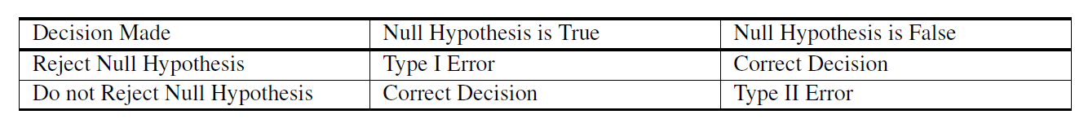
Type I and Type II Errors
Type I Error – Type I error occurs when the researcher rejects a null hypothesis when it is true. The term significance level is used to express the probability of Type I error while testing hypothesis. The significance level is represented by the symbol α(alpha).
Type II Error – Accepting a false null hypothesis H₀ is referred as the Type II error. The term power of the test is used to express the probability of Type II error while testing hypothesis. The power of the test is represented by the symbol β(beta).

Slide 19
Type I and Type II Errors
Sometimes we might get sample means that are extremes – that is going to happen about 5% of the time, since 95% of all sample means fall within about two standard deviations of the mean.
What happens if we run a hypothesis test and we get an extreme sample mean?
It won’t look like our hypothesized mean, even if it comes from that distribution. We would be likely to reject the null hypothesis.
But we would be wrong.

Slide 20
Critical Values/Region
Critical values are the values that indicate the edge of the critical region.
Critical regions describe the entire area of values that indicate you reject the null hypothesis.
In other words, the critical region is the area encompassed by the values not included in the initial claim - the area of the ’tails’ of the distribution.

Slide 21
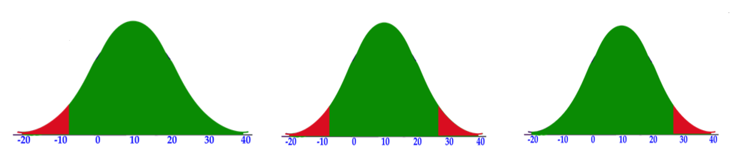
How to calculate critical value?
For 0.05 level of significance
0.05
0.025
0.05
0.025

Slide 22
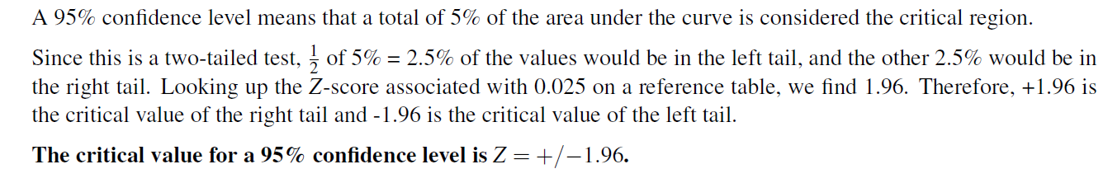
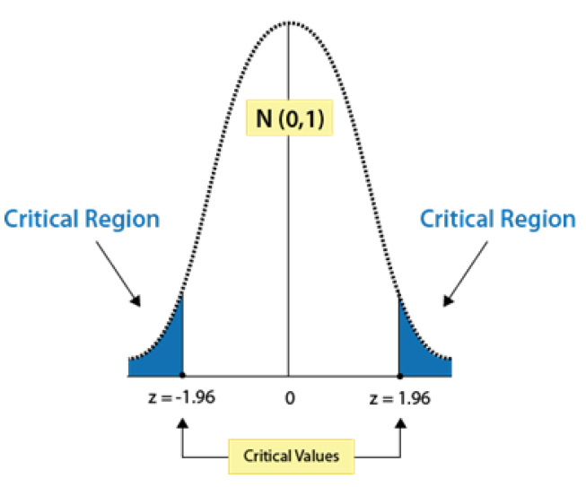
Locating a Critical Value

Slide 23
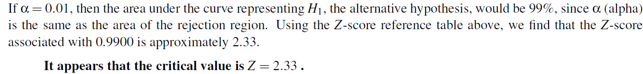
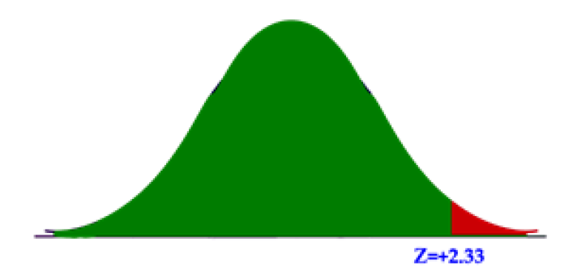

Slide 24
General Steps of Hypothesis Testing
1. State the null and alternative hypotheses.
2. Select the appropriate significance level and check the test assumptions.
3. Analyze the data and compute the test statistic.
4. Interpret the result

Slide 25
One Sample Mean When the Population Parameters are Known
We find the z-statistic of our sample mean in the sampling distribution and determine if that z-score falls within the critical (rejection) region or not.
This test is only appropriate when you know the true mean and standard deviation of the population.

Slide 26
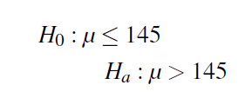
The school nurse thinks the average height of 7th graders has increased. The average height of a 7th grader five years ago was 145 cm with a standard deviation of 20 cm.
She takes a random sample of 200 students and finds that the average height of her sample is 147 cm. Are 7th graders now taller than they were before? Conduct a single-tailed hypothesis test using a .05 significance level to evaluate the null and alternative hypotheses.

Slide 27
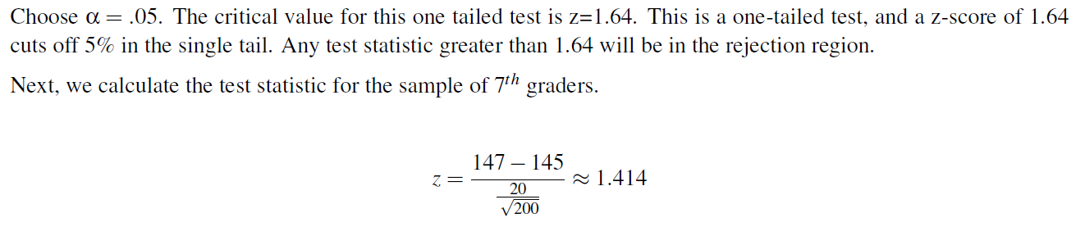

Slide 28
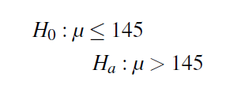
A farmer is trying out a planting technique that he hopes will increase the yield on his pea plants. The average number of pods on one of his pea plants is 145 pods with a standard deviation of 100 pods.
This year, after trying his new planting technique, he takes a random sample of his plants and finds the average number of pods to be 147.
He wonders whether or not this is a statistically significant increase. What are his hypotheses and the test statistic?

Slide 29
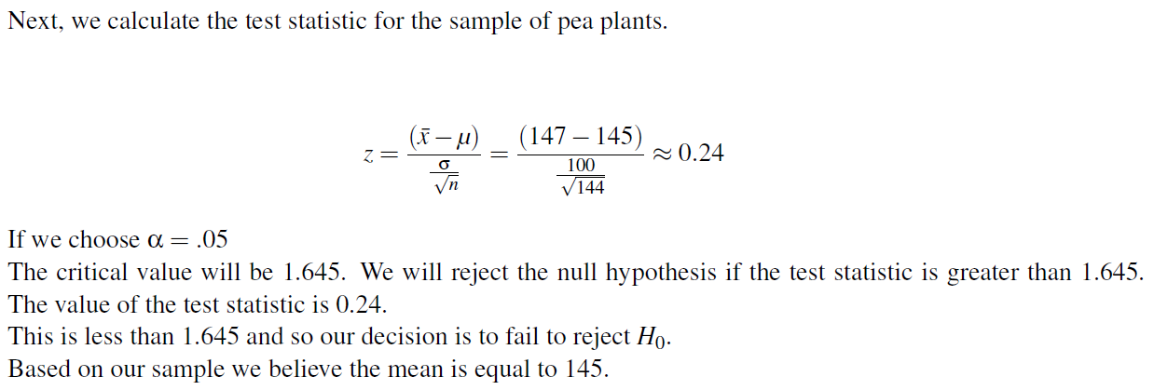

Slide 30
Reporting P-Values as an Alternative to Looking at Critical Regions
We can also evaluate a hypothesis by asking, “What is the probability of obtaining the value of the test statistic, if the null hypothesis is true?” This is called the pvalue.

Slide 31
Interpreting a p- value
To make a proper decision about whether or not to reject H₀ , you determine your cutoff probability for your p- value before doing a hypothesis test; this cut off is called an alpha level (α)
If p value is greater than or equal to α, you fail to reject H₀
If p value is less than α, you reject H₀

Slide 32
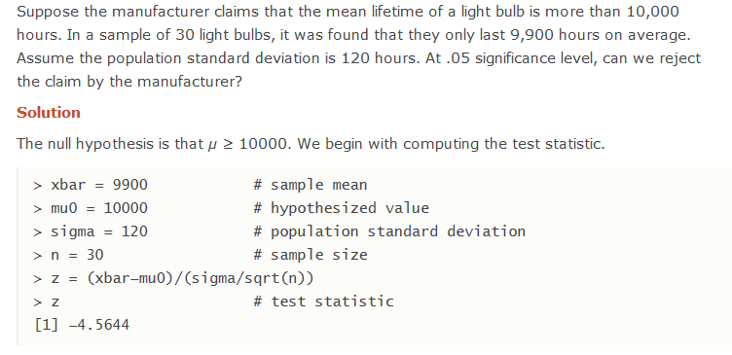
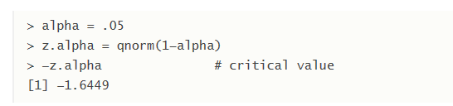

Notes:
http://www.r-tutor.com/elementary-statistics/hypothesis-testing/lower-tail-test-population-mean-known-variance

Slide 33
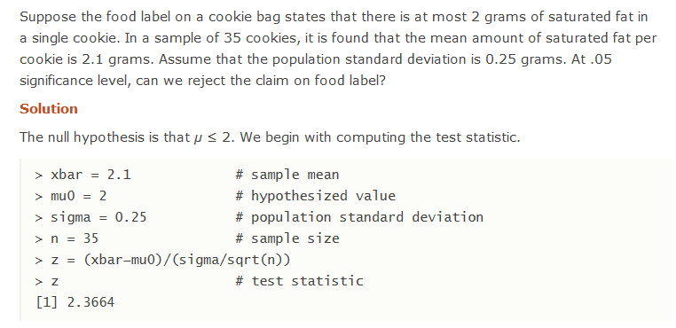
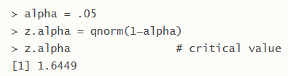


Slide 34
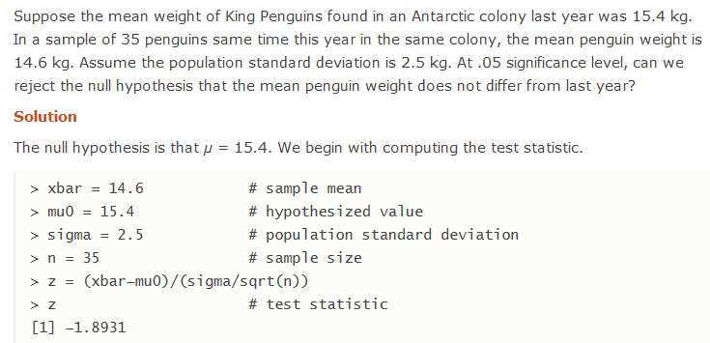
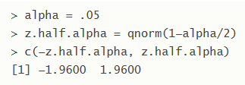

Notes:
http://www.r-tutor.com/elementary-statistics/hypothesis-testing/two-tailed-test-population-mean-known-variance

Slide 35
Hypothesis Tests When You Don’t Know Your Population Parameters
A z-test makes for an easy hypothesis test, but most of the time we can’t use it.
The reality is that most of our analyses are done when we don’t know what is true about a population.
When sample sizes changed, the shape of the distribution changed as well
Distributions for small sample sizes are now known as “Student’s t distributions.”

Slide 36
The Student’s t-distribution is similar to the normal distribution, except it is more spread out and wider in appearance, and has thicker tails.
As the number of observations gets larger, the t-distribution shape becomes more and more like the shape of the normal distribution.
In fact, if we had an infinite number of observations, the t distribution would perfectly match the normal distribution.
It is the t-distribution that allows us to test hypotheses when we don’t know the true population standard deviation

Slide 37
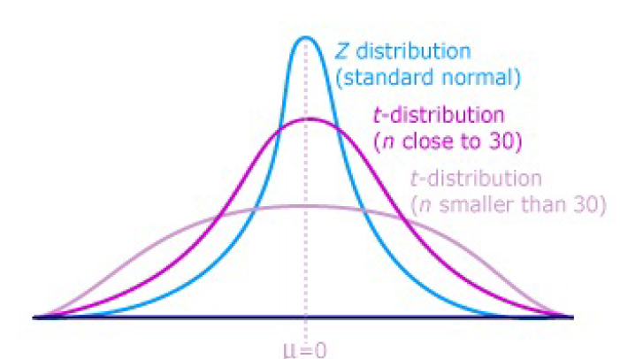

Slide 38

The differences between the t-distribution and the normal distribution are more exaggerated when there are fewer data points, and therefore fewer degrees of freedom.
Degrees of freedom are essentially the number of samples that have the ’freedom’ to change without affecting the sample mean. A

Slide 39
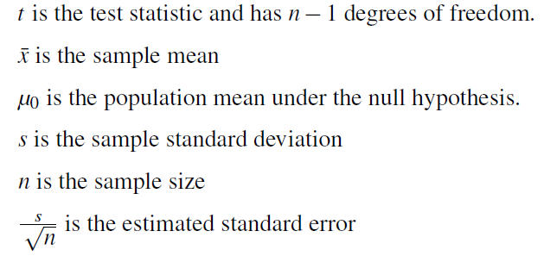

T-Test for One Sample Mean
We use the Student’s t distribution in hypothesis testing the same way that we use the normal distribution.
Each distribution is associated with a unique number of degrees of freedom (the number of observations minus one).

Slide 40
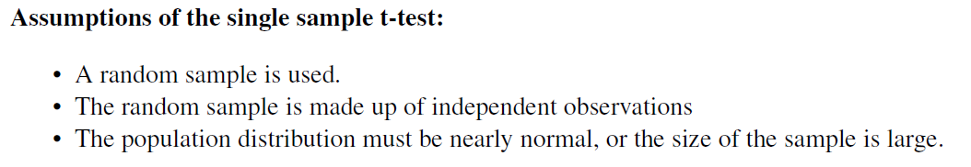

Slide 41
The high school athletic director is asked if football players are doing as well academically as the other student athletes. We know from a previous study that the average GPA for the student athletes is 3.10. After an initiative to help improve the GPA of student athletes, the athletic director randomly samples 20 football players and finds that the average GPA of the sample is 3.18 with a sample standard deviation of 0.54. Is there a significant improvement?
Use a 0.05 significance level.

Slide 42
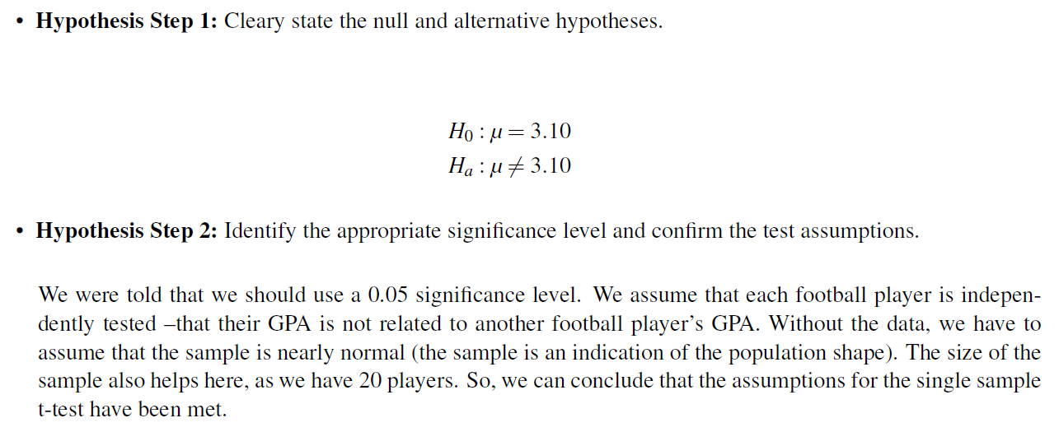

Slide 43
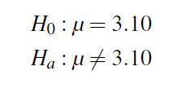
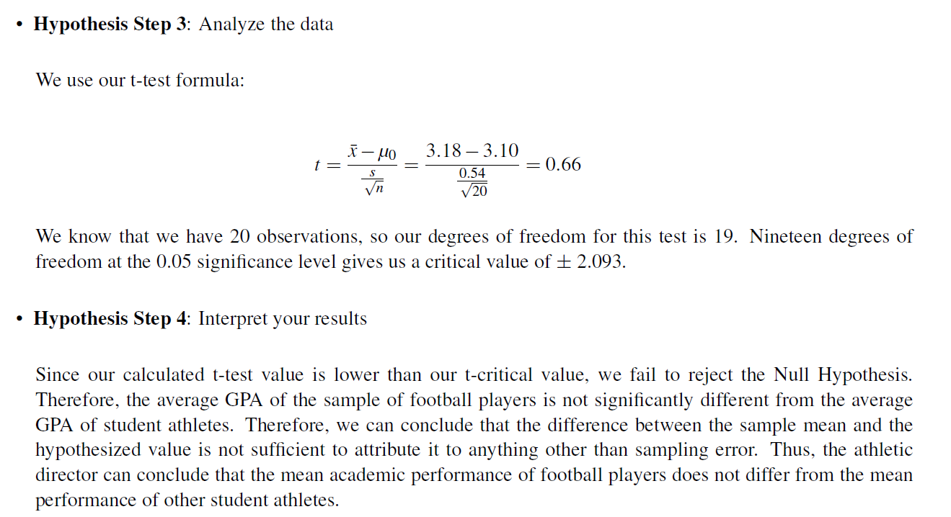

Slide 44
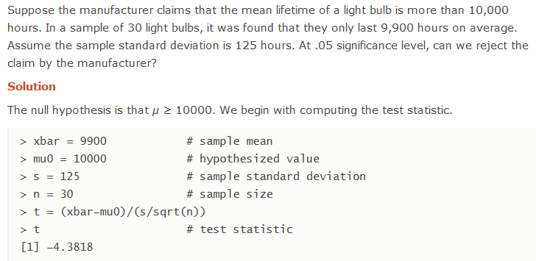
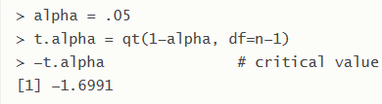


Slide 45
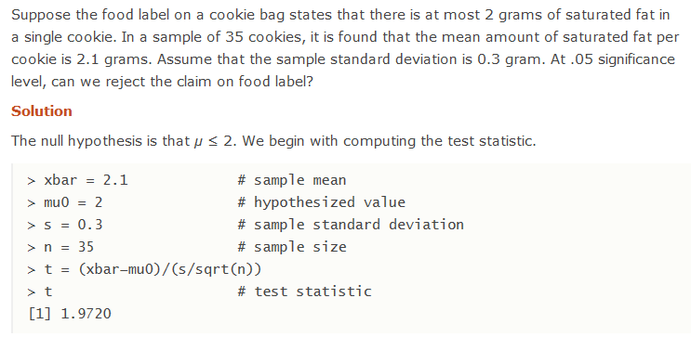
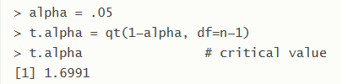


Slide 46
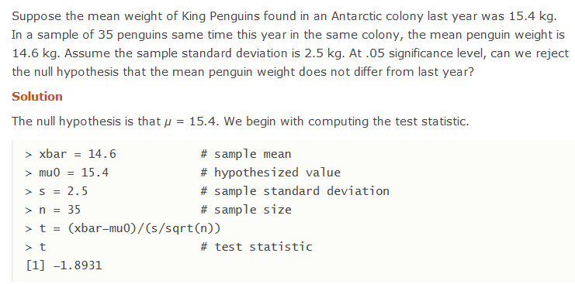
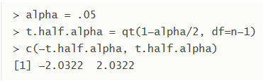


Slide 47
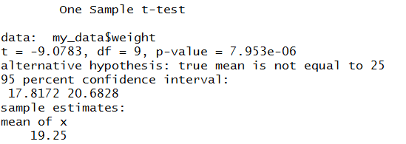
Data set containing the weight of 10 mice.
We want to know, if the average weight of the mice differs from 25g?
set.seed(1234)
my_data <- data.frame( name = paste0(rep("M_", 10), 1:10), weight = round(rnorm(10, 20, 2), 1))
#We want to know, if the average weight of the mice differs from 25g (two-tailed test)?
# One-sample t-test
t.test(my_data$weight, mu = 25, alternative = “two-sided")
In R the p-value is addition of both the tails/ critical region

Slide 48
#if you want to test whether the mean weight of mice is less than 25g (one-tailed test), type this:
t.test(my_data$weight, mu = 25, alternative = "less")
#Or, if you want to test whether the mean weight of mice is greater than 25g (one-tailed test), type this:
t.test(my_data$weight, mu = 25, alternative = "greater")

Slide 49
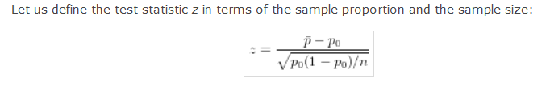
Hypothesis Test in Porportion

Slide 50
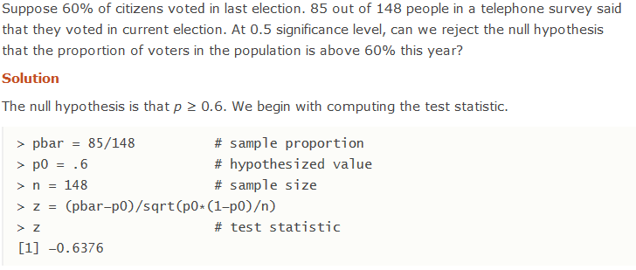
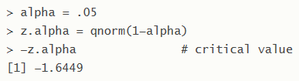
Notes:
http://www.r-tutor.com/elementary-statistics/hypothesis-testing/lower-tail-test-population-proportion

Slide 51
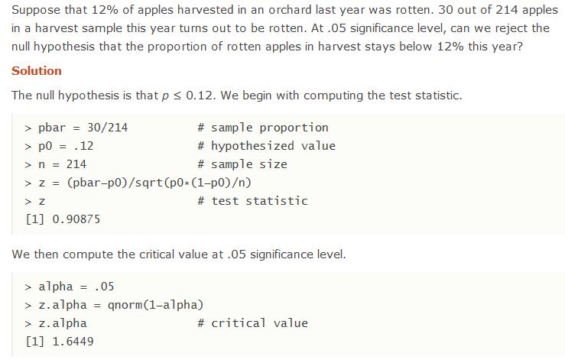

Slide 52
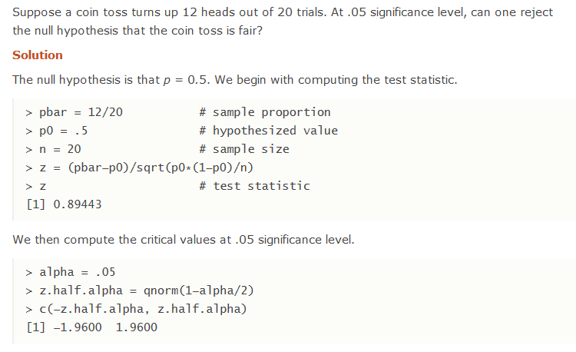

Slide 53
Duracell manufactures batteries that the CEO claims will last an average of 300 hours under normal use. A researcher randomly selected 20 batteries from the production line and tested these batteries. The tested batteries had a mean life span of 270 hours with a standard deviation of 50 hours. Do we have enough evidence to suggest that the claim of an average lifetime of 300 hours is false?

Slide 54
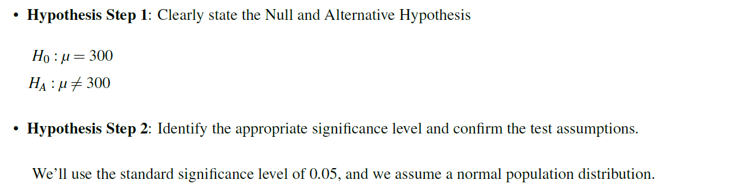

Slide 55
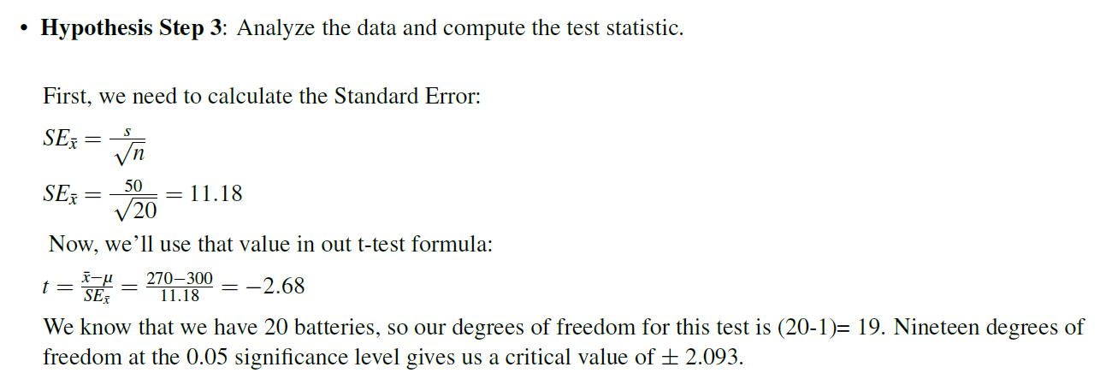

Slide 56
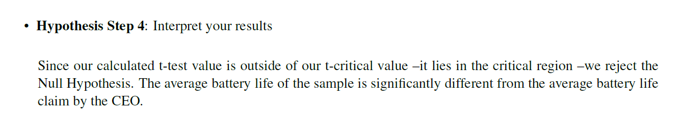

Slide 57

Hypothesis Testing Procedure
Set up the null and alternate hypothesis
Take a random sample of individuals from a population and calculate the sample statistics(means and S.D)
Convert the sample statistic to test statistic by changing it to a standard score(Z score)
Find the p value of your test statistic
Examine your p value and make our decision
Do you remember me???

